Slide 1
CTI League
Disinformation
2020-07-16
Anti-Medical-Safety Disinformation Think Tank

Slide 2
Persistent Threats:
AntiVax

Slide 3
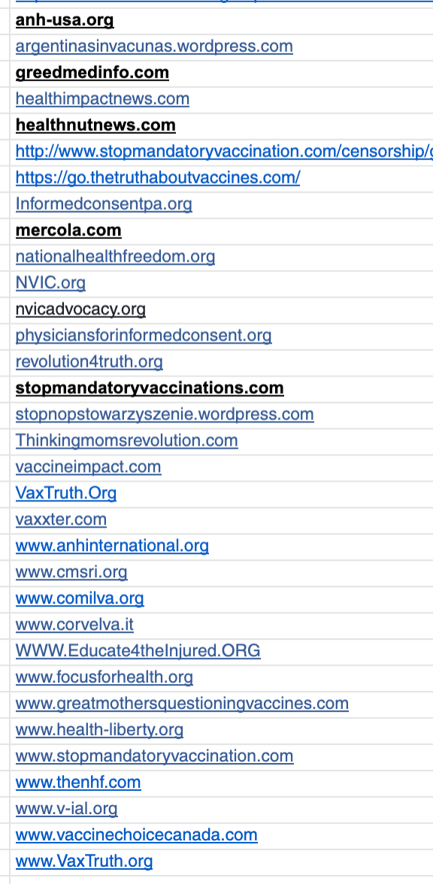
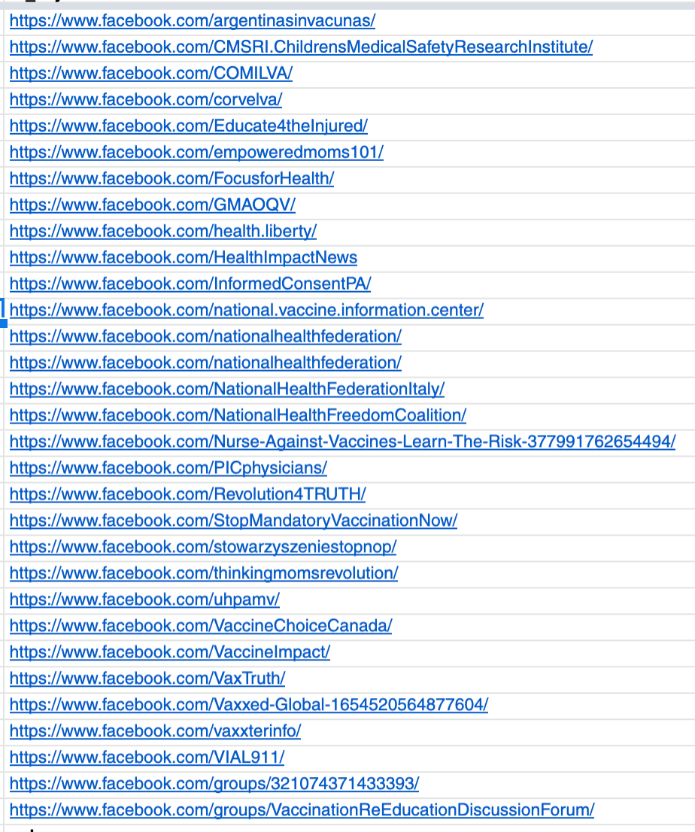
Antivax Groups (Hive Persistent Case 40)

Slide 4
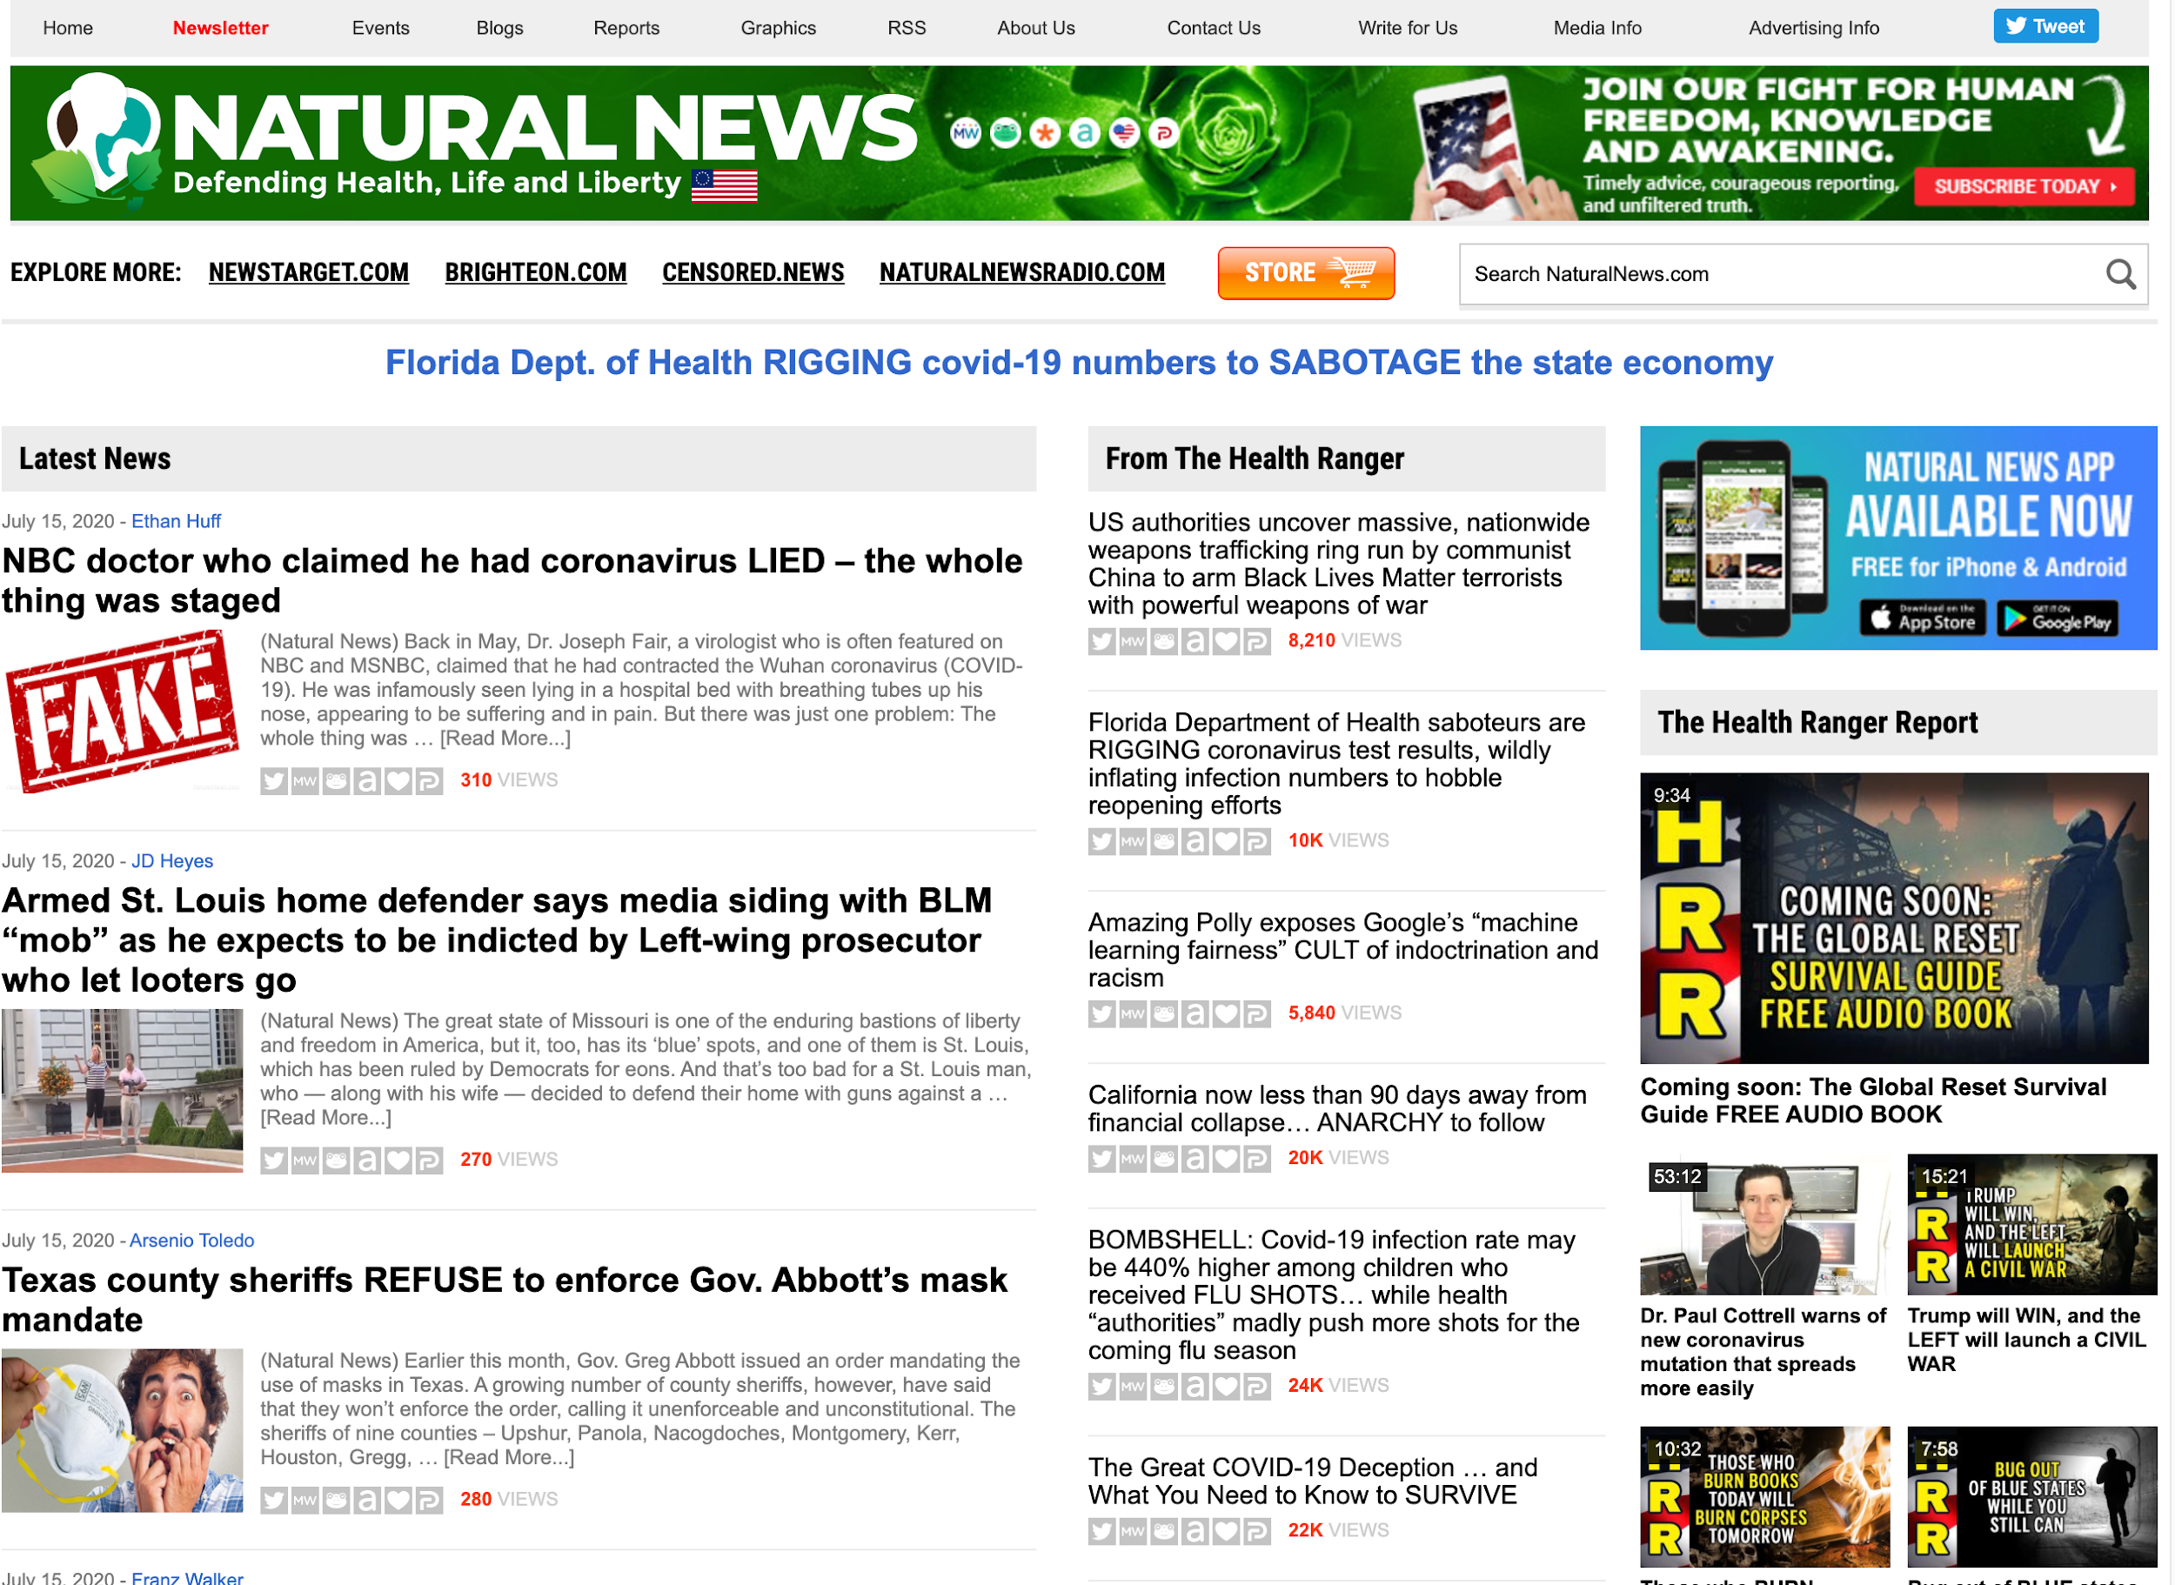
Antivax Superspreaders: NaturalNews
Notes:
Naturalnews.com and about 40 other sites in its network.

Slide 5
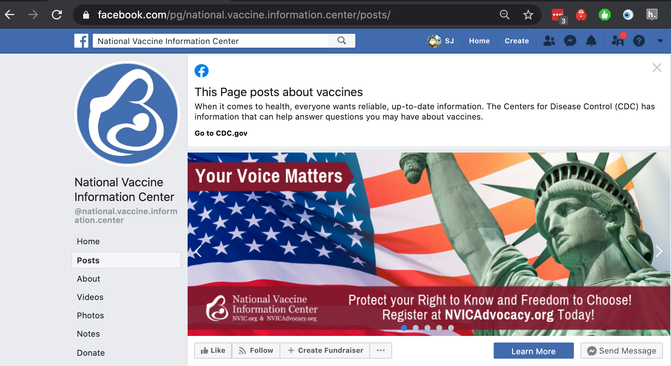
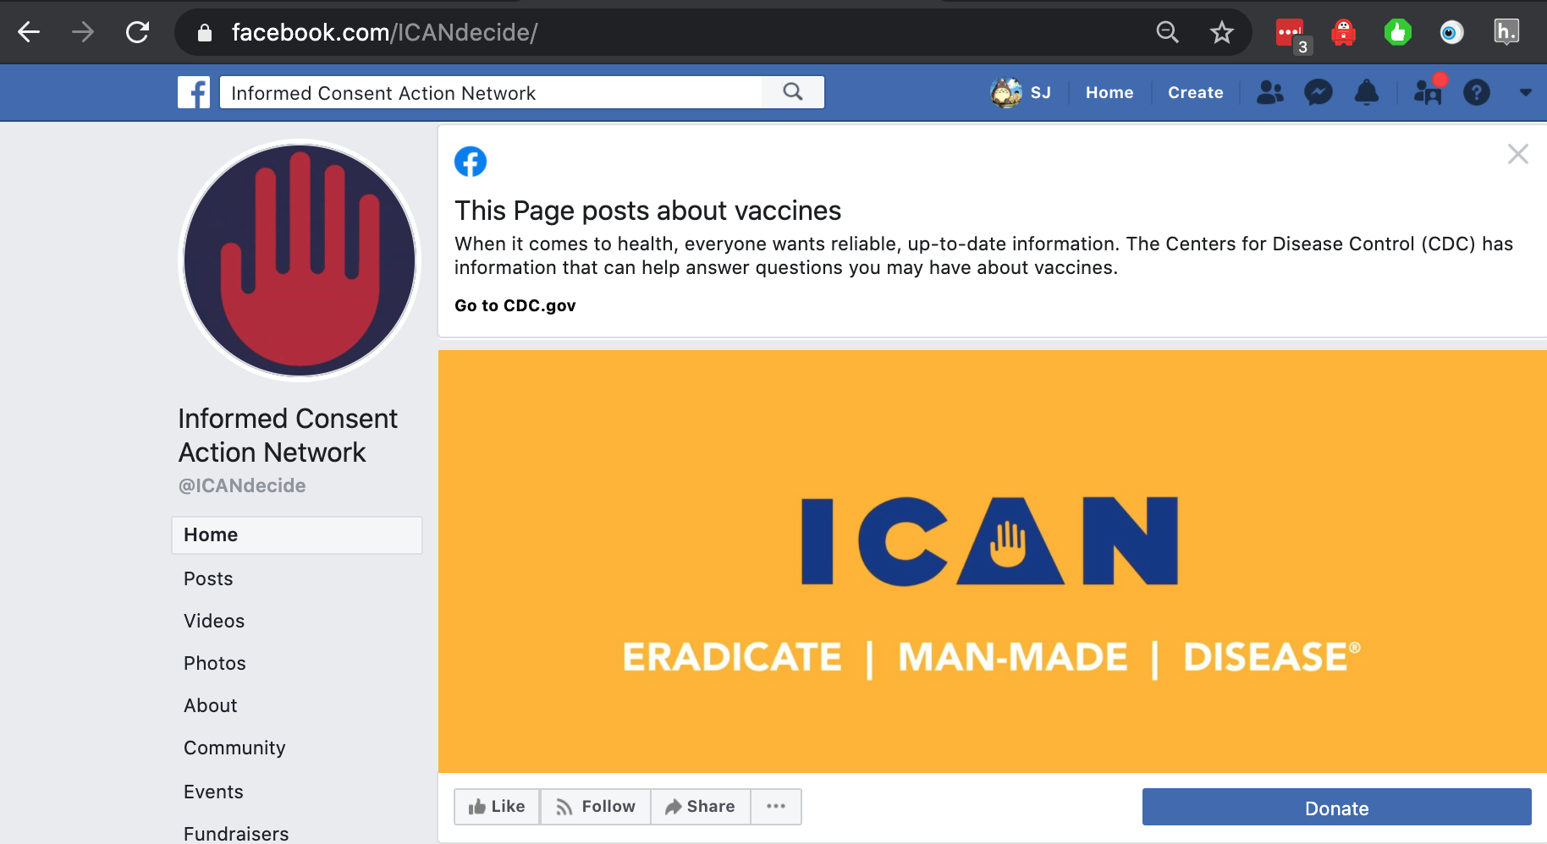

More Superspreaders
Notes:
National Vaccine Information Center, Informed Consent Action Network, Children’s Health Defense (yes, that is *that* [Name Redacted] )

Slide 6
Anti-vax narratives
Vaccines cause autism
Antibiotics treat measles etc
Vaccination is communist
Mercury in vaccines
Fetus cells in vaccines
Natural immunity
Bill Gates
Putting microchips inside us
...
Notes:
https://www.healthline.com/health-news/the-latest-anti-vax-conspiracies-could-be-harmful-to-kids#Vaccines-cause-autism:-False

Slide 7
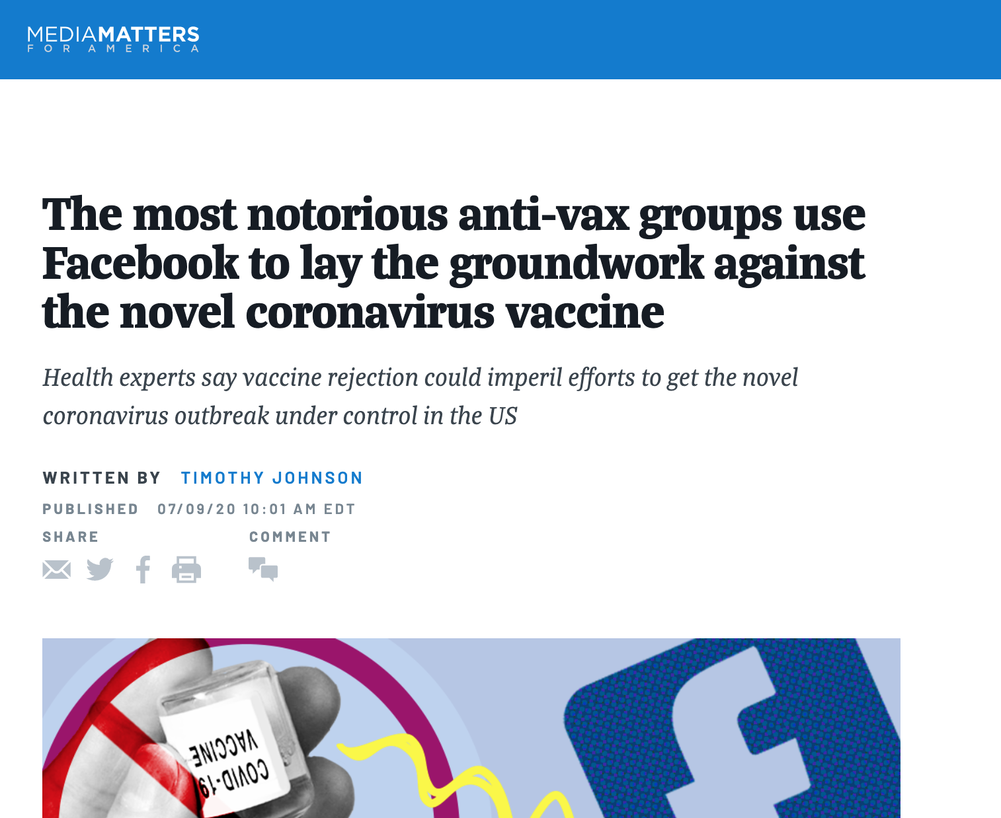
And the problem barrelling towards us
Notes:
https://www.mediamatters.org/coronavirus-covid-19/most-notorious-anti-vax-groups-use-facebook-lay-groundwork-against-novel

Slide 8
Current Iteration: Anti-Mask

Slide 9
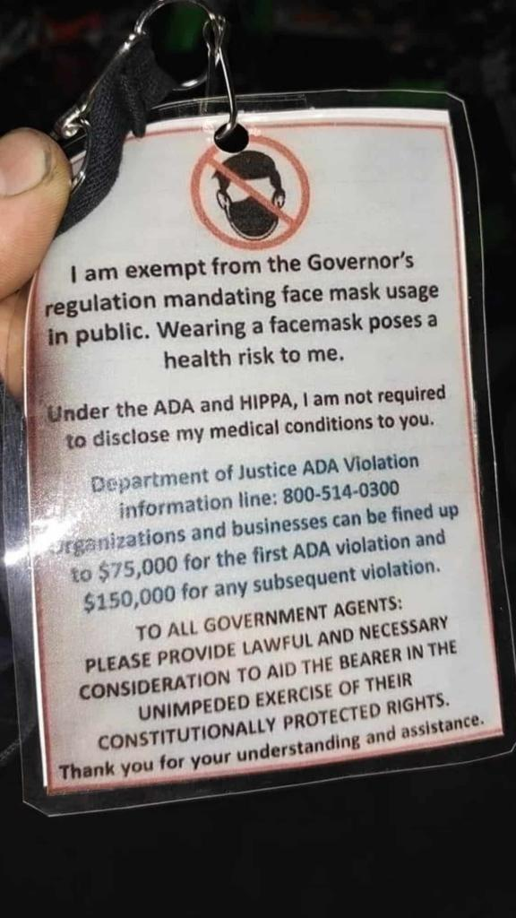
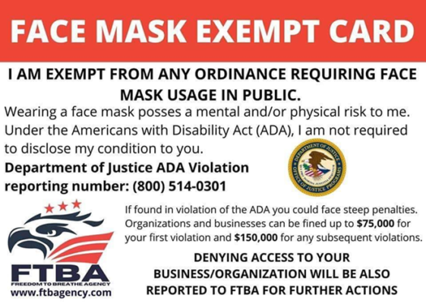
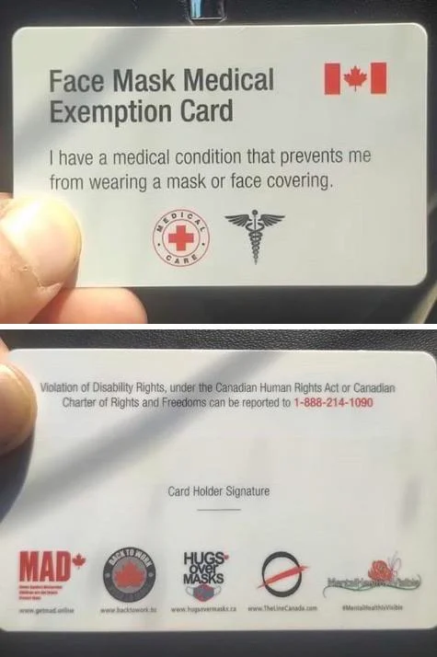
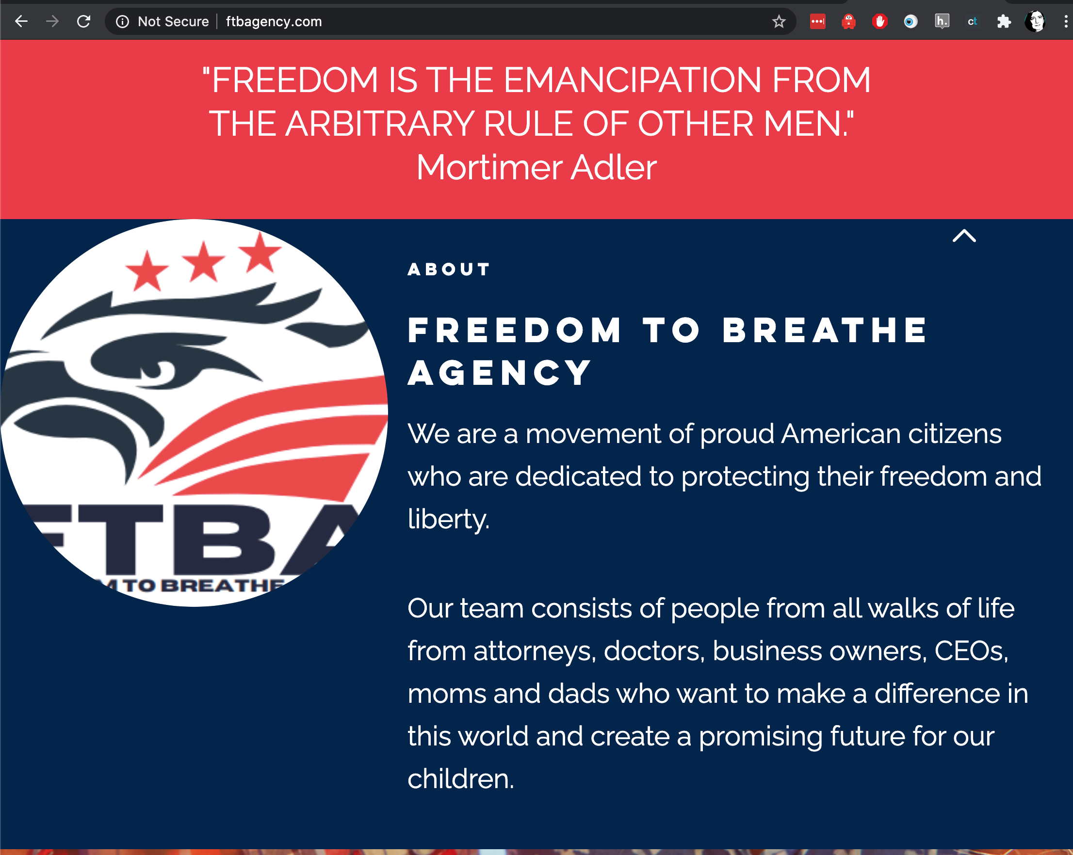
Face Mask Exemption Cards (Hive Case 51)

Slide 10
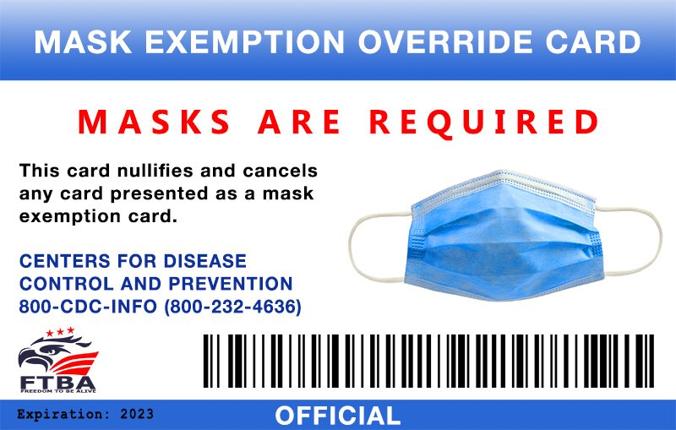
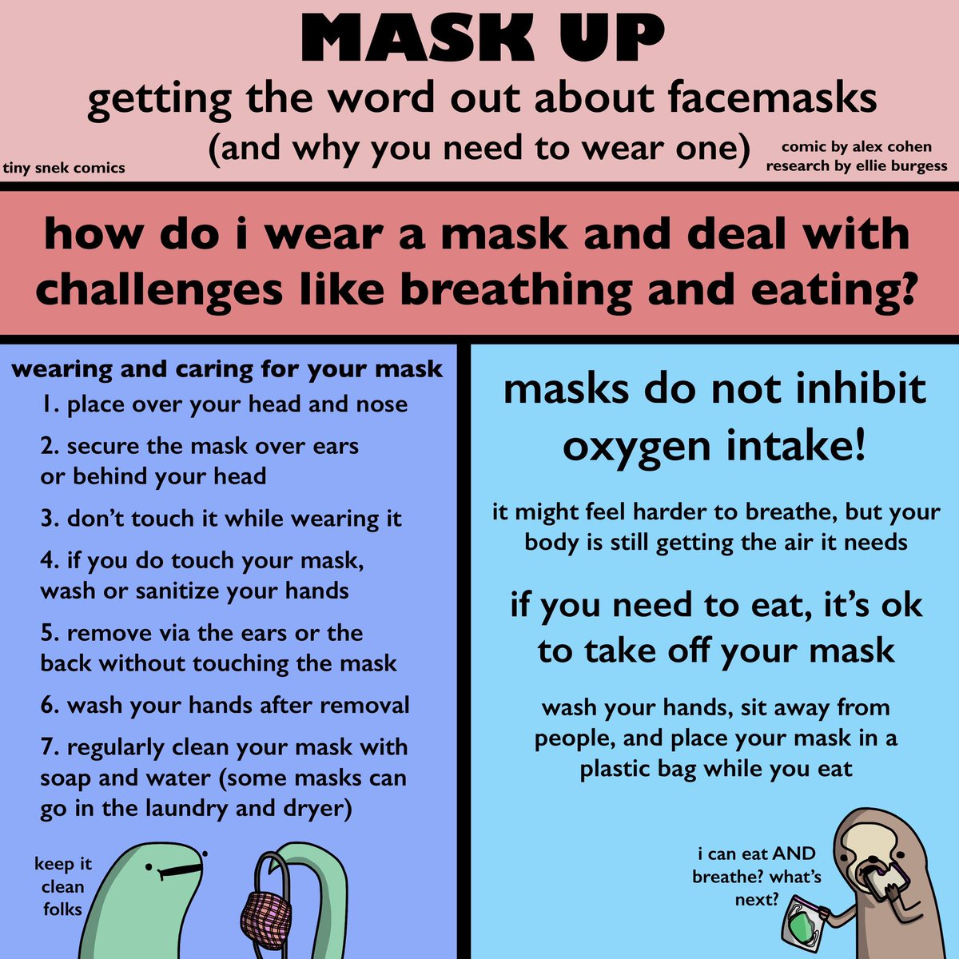
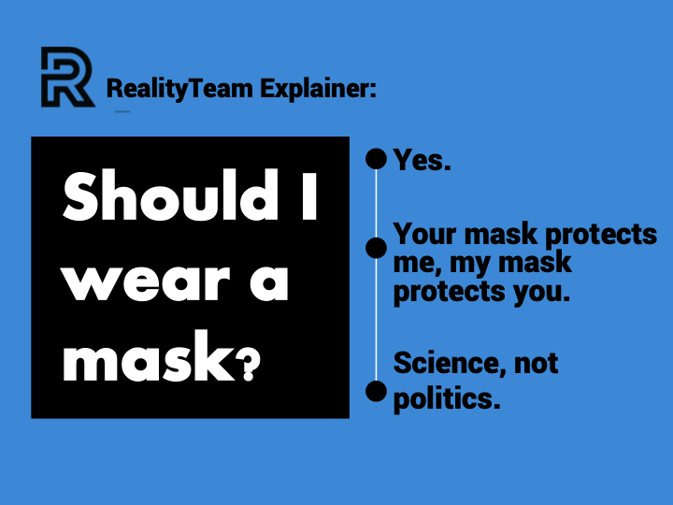
(New) Counters

Slide 11

Calls for Marches (Hive Case 52)

Slide 12
Anti-mask narratives
Masks aren’t effective against Covid19
Masks are a liberal plot
Masks create harmful CO2 exposure
Masks deprive the body of oxygen
Wearing a mask activates Covid19 (thanks, Plandemic…)
...
Notes:
https://www.bbc.com/news/53108405

Slide 13
System? Counters?

Slide 14
Some questions
How do we track persistent threats?
Where do we put data? How do we update it?
(design it)
Can we learn things from the antimask responses?
(blue team it)
Are the antimaskers and antivaxxers the same people?
(check data)
Are they driven by the same things?
(check data)
What other anti-medical-safety narratives might emerge?
(red team it?)
What other counters could we use?
(brainstorm / check counters list?)

Slide 15
From Narrative Training: Establish Baseline
Establish baseline of current threat landscape
Master Narrative
List of persistent threats known to carry disinfo
Known bots
Sources (Disinfo Websites)
Canaries (account or hashtags)
Regular Threat Streams
Feeds
Subscriptions
Platforms
Notes:
Master Narratives - Covid-19 - https://drive.google.com/file/d/1vc_IDiu9VA4ZusSFqSSfGon7EvZW5xmV/view?usp=sharing
Canaries - https://drive.google.com/file/d/1vc_IDiu9VA4ZusSFqSSfGon7EvZW5xmV/view?usp=sharing
Disinfo Websites - https://docs.google.com/spreadsheets/d/19UCUmwbI4VcleqrlwXor-6xPE44LccpJJsU3qz4w_cc/edit?usp=sharing

Slide 16
Persistent and Repeatable Monitoring
Develop repeatable methodology
Identify data sources to monitor - GoogleNews, Twitter, Facebook, other news aggregation sites
Create Saved or formatted searches per platform -
Twitter = #Disinformation, COVID, QANON, Boogaloo
Google = Google Hack formatted w/ time parameter
“Disinformation AND COVID when=1d”
Utilize other platform collection resources
TweetDeck
CrowdTangle

Slide 17
Over to you, think tank...

